Slide 1
Cost-Benefit Analysis

Slide 2
Framework
Impact analysis considers the effects of policies
Environmental impact analysis studies environmental impacts of actions
NEPA [National Environmental Policy Act of 1970] requires government agencies to perform environmental impact assessments of proposed legislation and government actions

Slide 3
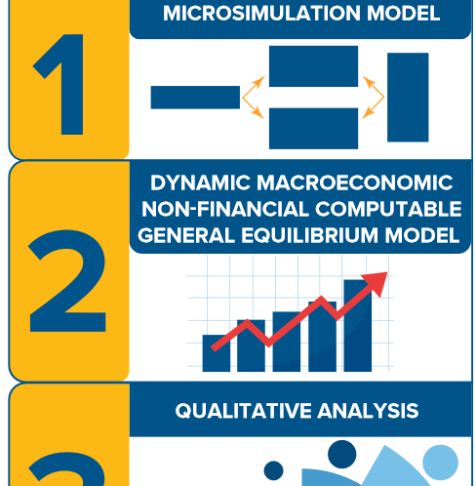
Economic Impact Analysis
Considers the economic impact from regulator actions
Effects on employment, GDP growth, and business formation
Can be positive or negative
Includes seen and unseen
Broken window fallacy

Slide 4
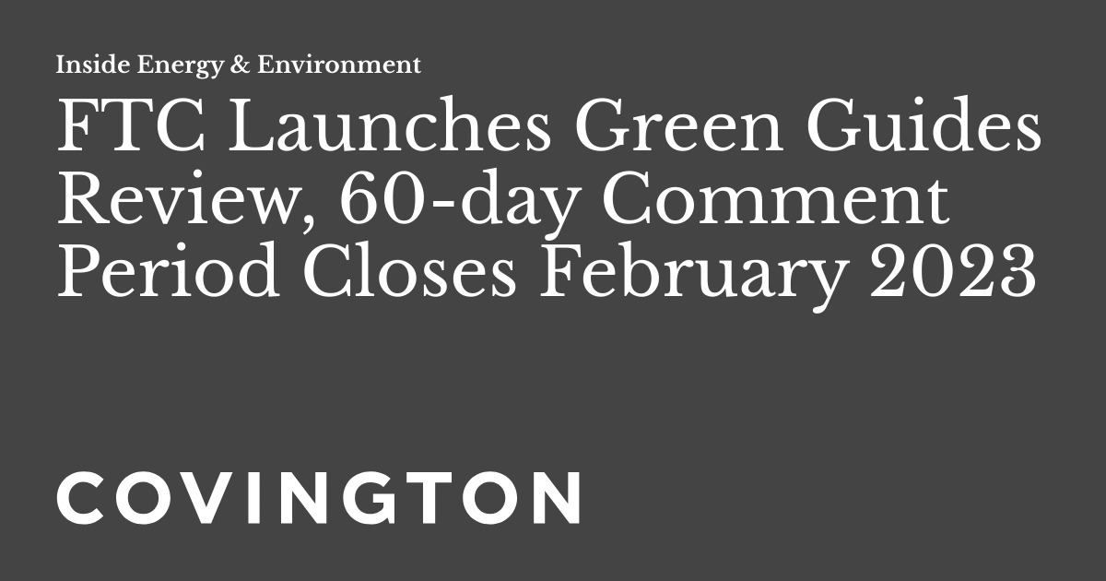
Regulatory Impact Analysis
Considers the impact of any regulation or repeal of regulation by an agency
Includes cost benefit analysis
60 day comment window

Slide 6
Damage assessment
Lost resource value: Loss of beauty and use of a resource. No more hiking, no more views, no more fishing
Restoration costs: What would we have to pay to replace what we lost or to acquire a similar resource?
What is the lost resource value of logging?
What is the restoration cost of an oil spill?

Slide 7
Issues with Evaluating restoration costs
What is the real original quality of the resource?
Some resources take a very long time to be created
Can resources truly be restored or replaced?

Slide 8
Framework of Cost-benefit analysis
Specify the project or program; specification, location, timing, groups involved, and connection to other programs.
Describe quantitative inputs and outputs of the program; typically monetary values.
Estimate the social costs and benefits of these inputs and outputs.
Determine the full range of consequences.
Compare the benefits and costs.

Slide 10
Must consider all costs and benefits: EPA emissions standards example

Slide 11
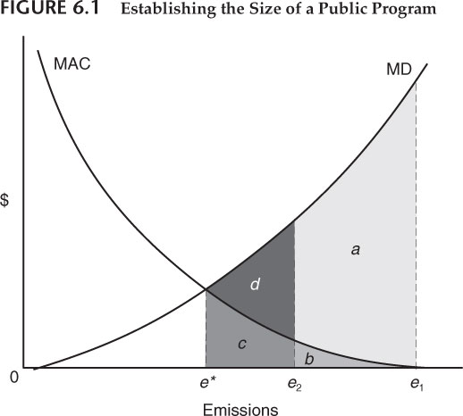
Equating costs and benefits
Total benefits=a+b
Total costs=b
Net benefits=a

Slide 12
Sensitivity analysis
If we change costs or benefits some, how do number change
If we check our assumptions, is it still worth it?
Reduction from e1
e*= [a+b+c+d] /[b+c]
e₂ = [a+b] /b

Slide 13
Distributional problems
Who should get benefits and pay costs?
Horizonal equity: How does the policy impact similar people with similar incomes?
Vertical equity: How does a policy impact people with different incomes?
Higher costs matter more to a poor person
People paying costs might not be those receiving benefits

Slide 14
Vertical Equity

Slide 15
Risk Analysis Assessment Steps
Risk assessment studies; where risk comes from and how people respond to it.
Risk valuation determines what values, willingness to pay, people place on risk reduction.
Risk management examines how different policies affect levels of environmental risk to which people are exposed.

Slide 16
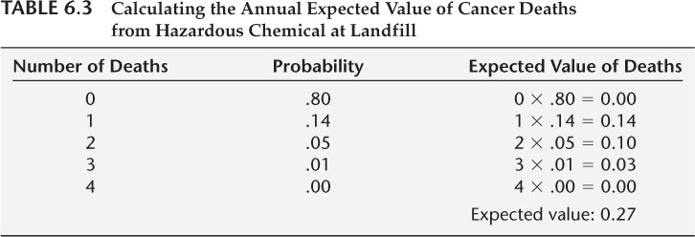
Risk valuation
Uses probabilities to calculate expected values of risks
Values reduction in risks based on risk aversion

Slide 17
Risk aversion is about expected values

Slide 18
Covid masking was a difference in risk aversion

Slide 19
Risk Management
Risk has been valued, now policies for dealing with it are considered
Example: EPA considering if a pesticide should be allowed on the market
Does a study comparing the benefits for farmers and consumers
production cost savings
when the pesticide is used
increased health risks to farm workers, community and possibly consumers.
Comparative–risk analysis: examines different policy options and levels of risk
waste management
water supply systems

Slide 20
Find highest benefit-to cost ratio of an emissions reduction

Slide 21
Benefits

Slide 22
What are some ways we could measure benefits?

Slide 23
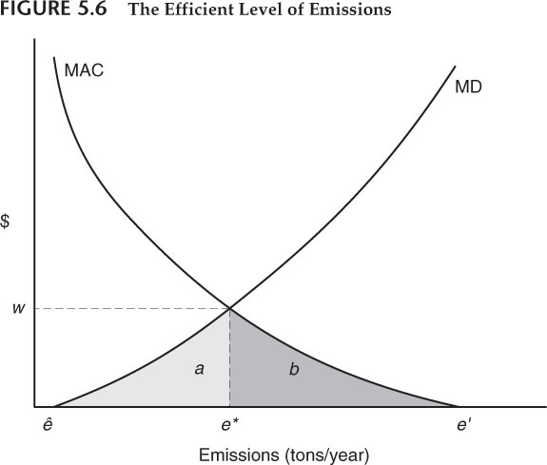
Damage functions
Determine the emission
Estimate the resulting human exposure
Estimate the physical impacts of these exposure levels
Determine the values associated with these physical impacts

Slide 24
Damages to human health from pollution
Increase mortality and morbidity
emphysema, lung cancer, and asthma.
Confused by other factors e.g. lifestyle, diet, and genetic factors
Epidemiologists derive statistical results from large data sets.
Establish relationships between ambient pollution and human health effects
A 1% reduction in air pollution produced a .12% reduction in death rates.
Statistical estimates can be used in benefit-cost studies.

Slide 25
Measuring Damage costs: Cost of Illness approach
Estimate the increased costs associated with pollution-related illnesses.
Direct costs
hospital, doctors, medicine
indirect costs
decreased productivity
With the COI approach, benefits of pollution control are reduced health-related costs.
Indices are often monetized to develop estimates to compare with the costs of pollution control.
Do not rely on the concept of WTP.

Slide 26
COI approach

Slide 27
How to establish production cost value?
Air pollution: Crop yields
Water pollution: Fishing and drinking water, decreased recreational sales
Soil pollution: Decreased agricultural production
Workplace pollution: Less capital, less productivity

Slide 28
Chinatown

Slide 29
Before and after pollution production: q2 to q1

Slide 30
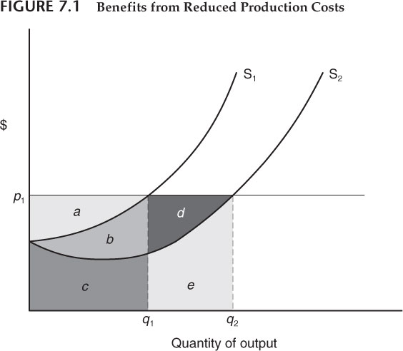
Reduction in net income
Total value-total cost=net income
Reduction from q2 to q1:
([a+b+c+d+e]-[c+e])-([a+b+c]-[b+c])=a+b+d-a=b+d

Slide 31
Issues with Direct Damage Approach
Incomplete
Marxist perspective on value
Does not consider non-market benefits and aesthetic value
When is direct damage best approach?

Slide 32
How do Economists measure benefits?
Willingness to pay.
How much would someone pay for some amount of environmental quality improvement?
Why is this difficult to measure?

Slide 33
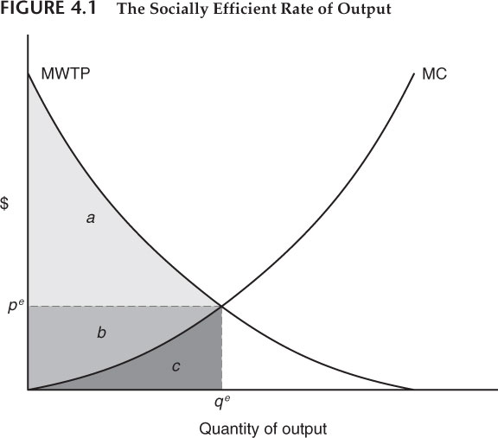
Willingness to pay for environmental quality: Practical Issues
No markets for environmental quality
Environmental quality is often a public good
Often beneficiaries are not even alive
Revealed vs stated preferences
Some people can’t pay

Slide 34
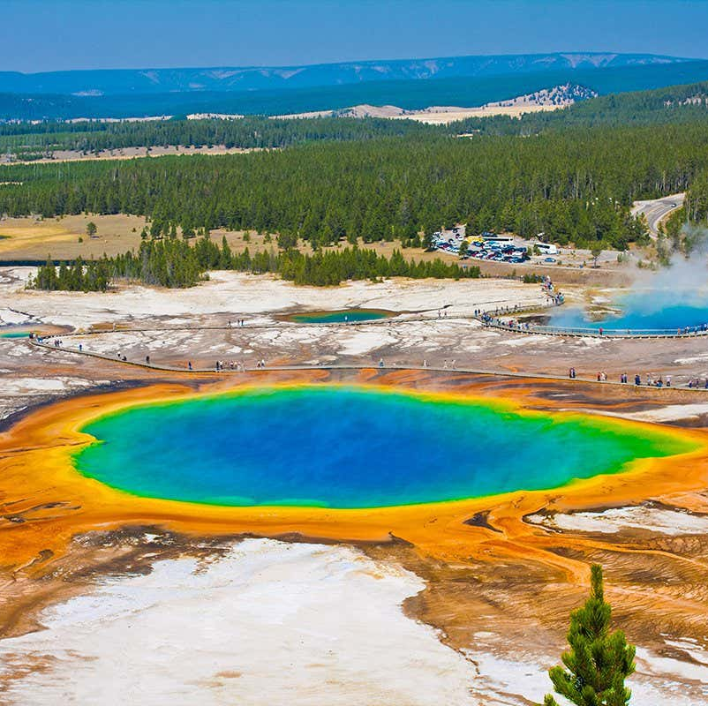
Willingness to pay for environmental quality: Possible Solutions
Differences in housing prices: Two houses that provide the same amenities may differ in price based on environmental quality.
Surveys: Ask people how much they would be willing to pay
How much would be people be willing to pay to travel to a place? (Plot of Yellowstone)

Slide 35
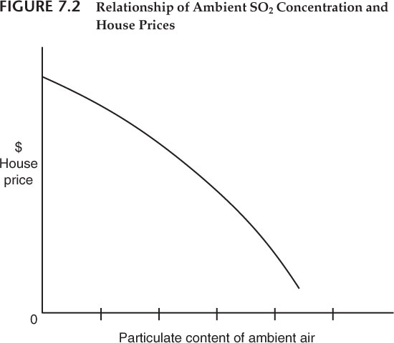
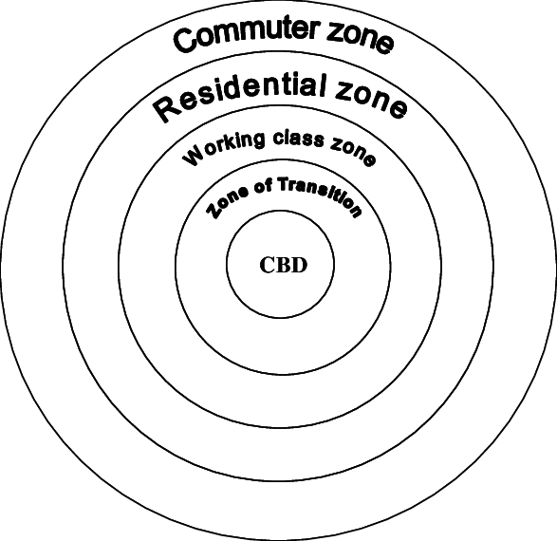
Urban economics of housing prices
Where is property most expensive?
How does this square with the willingness to pay for environmental quality?

Slide 36
Statistical Value of life
Based on how much an individual would be willing to pay to reduce probability of death
If average person is willing to pay 20 dollars to reduce the probability of death by .0001%, the statistical value of human life is 100,000*20=2,000,000
This is the willingness to pay for reductions
Problems with approach

Slide 37
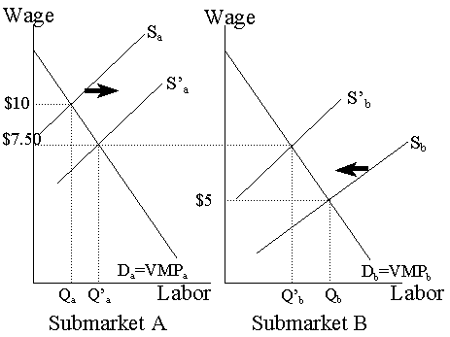
This value is revealed in labor markets
Market pays a premium for riskier jobs
Workers require risk premium
Can be used to establish value of life and the value of environmental improvement
Sometimes differences in wages noisy

Slide 40
Contingent valuation analysis (surveys)
Identify and describe the environmental quality characteristic or outcome to be evaluated.
Identify respondents to approach with sampling procedure.
Design and process for the survey questionnaire
Analysis of results
Example: Davis estimated the benefits of outdoor recreation opportunities in Maine using WTP per family was between $1-$2 per day.[1963].
Problems?

Slide 41
Implied statistical life using contingent valuation

Slide 42
Problems in benefit estimation
People have trouble thinking about hypothetical scenarios
Willingness to pay vs. Willingness to accept
People don’t realize how important things are until they lose them
Sometimes, the value is not to people but for conservation

Slide 43
Costs

Slide 44
The with and without principle
Cannot simply consider current costs versus costs after policy
Must consider costs in a world with the policy versus costs in a world without
If costs are 100 now but will increase to 150 with the regulation but 120 without the regulation, the cost of the regulation is 30

Slide 45
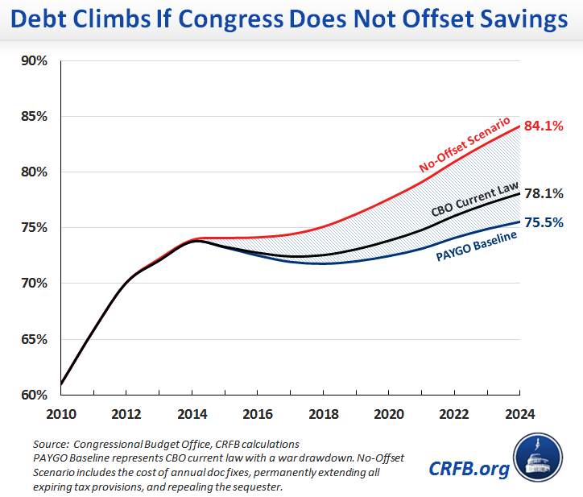
Baseline: an-intensive model-driven process
Entire teams of people work to estimate baseline growth and costs
Even then, they often get it wrong

Slide 46
The hard part about obvious policies: Flood insurance

Slide 47
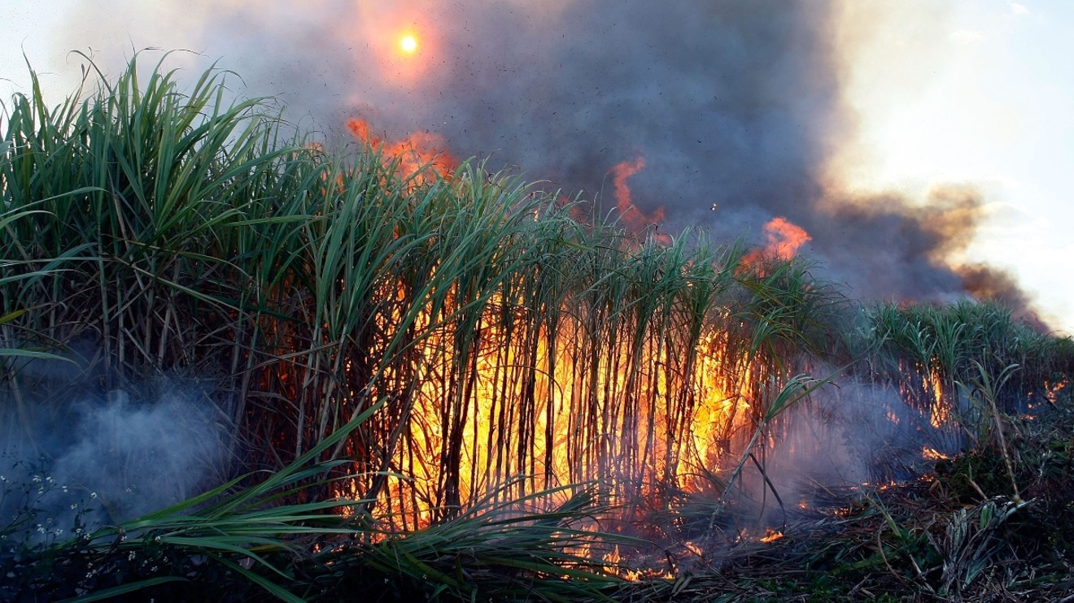
The hard part about obvious policies: Agricultural Subsidies

Slide 48
Distribution of costs: Who do regulations hurt?
When regulation affects the costs of one industry this can impact the employment and costs of several other industries as well as overall GDP.
There may be important regional differences in what groups benefit and what groups are burdened with the costs.
It is important to not only examine the total costs but how these costs are distributed.

Slide 49
Environmental Protection can have Environmental Costs
Reducing untreated domestic waste outflows into rivers leaves quantities of solid waste that need disposal.
Reducing airborne SO₂ emissions from power plants leaves highly concentrated sludge that needs disposal.
The mitigation costs must be included as part of the total costs of overall pollution reduction.
Enforcement costs must also be included.

Slide 50
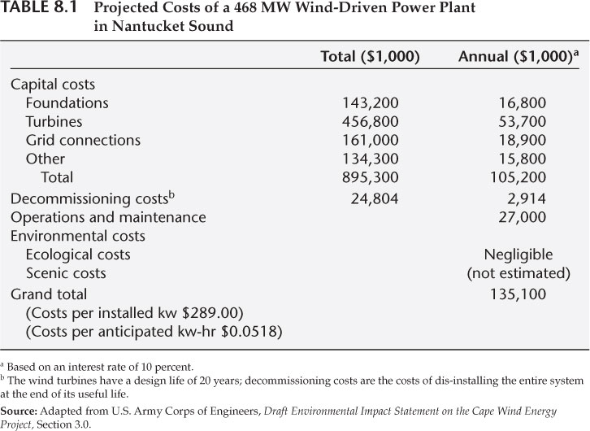
Costs of procuring and installing turbines
Land costs from turbines cannot be excluded from cost estimation

Slide 51
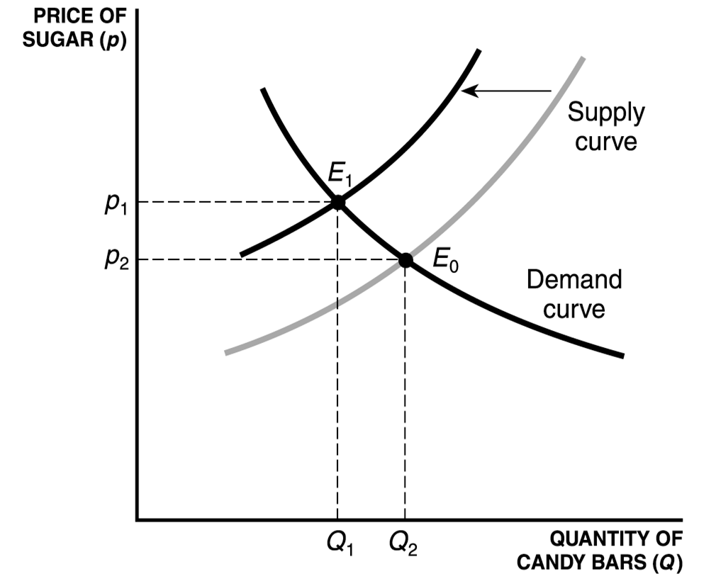
Social costs of regulation
Lost of jobs
Shrinking of lower markets
Resources move to lower value uses

Slide 52
Example: Apples
Integrated pest management; required a lower level of chemical use increasing the cost of growing apples.
What other examples can you think of?

Slide 53
Cost of Regulating Industry
Standard approach: estimate increased industry production costs or added expenditures for compliance.
Can be difficult when polluters are given latitude in making their response.
Always expect that costs of enforcement will be higher.
People are creative e.g. Mail fraud
Large number of firms in the industry? estimates are done for a sample of these firms and an average is used.

Slide 54
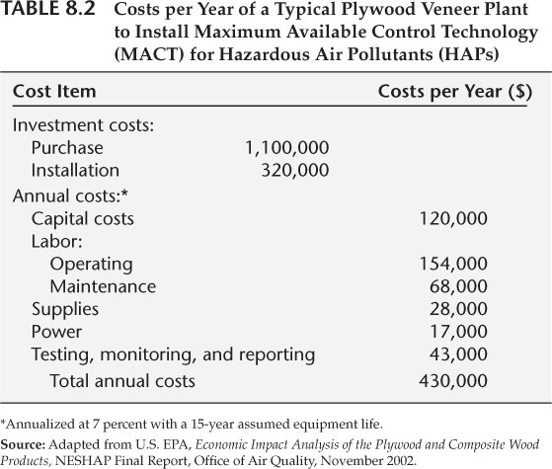
Example from textbook
Total costs per plant [$430,000] * [61] firms in this industry = [$26,230,000] the total expected national costs of this regulation. The cost effectiveness to reduce 610 tons emissions is estimated at $26,230,000/ 610 = $43,000 per ton.

Slide 55
How to get cost data
Costs surveys
Historical data
The representative firm approach.
Issues?
Regulated firms have private information about their costs
Costs estimated
may not represent minimum abatement costs.

Slide 56
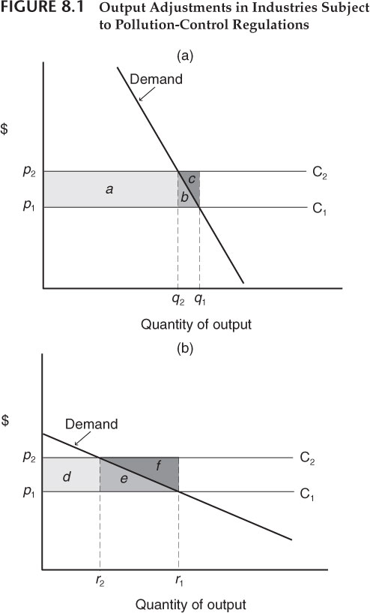
Price output adjustment
Demand curve impacts the societal effects of cost adjustment
Elastic demand curves lead to higher cost. Why?
What else effects cost to industry from a market perspective?

Slide 57
Long-run technical change and costs
Research and development can lower pollution abatement costs
new methods in production
increased recycling process
new treatments for residuals
When firms are faced with regulation, they innovate
Short run costs become higher than long run cost

Slide 58
Enviro-tech industry
Firms producing goods and services used by other firms to reduce their emissions and environmental impact
Environmental clean-up
New pollution control technology and practices
Instrumental in lowering future marginal abatement costs
Huge potential employer for people in this room!!!

Slide 59
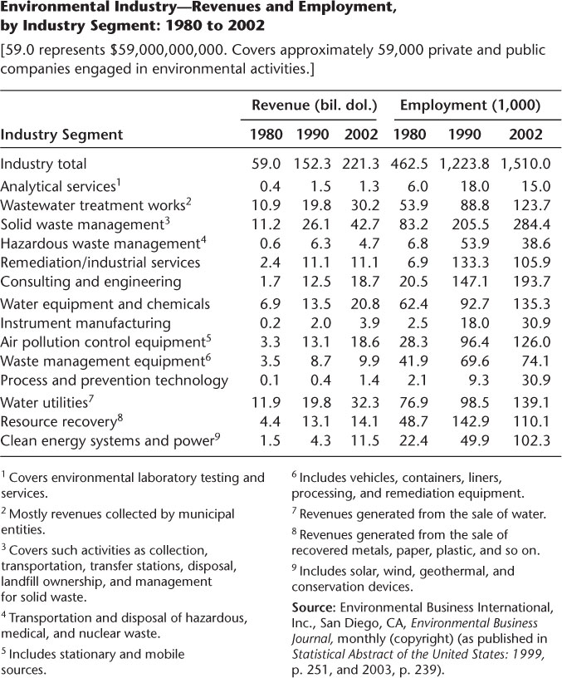
Regulation adds to economic production
Lots of people employed
These people help GDP, cost money to budgets

Slide 60
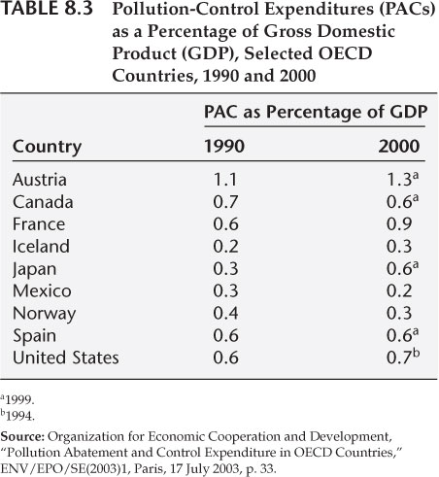
Costs at the national level: CO2 emission reduction
The bottom-up approach
The sum the firms’ cost of pollution abatement and lost production.
Economy-wide surveys: estimate the size of pollution abatement costs.
Difficulty including estimates of expenditures detracted from other outputs.
Benefits of approach?

Slide 61
Top-down analysis: macroeconomic modeling.
How much has pollution-control expenditures resulted in lowering the national economic performance?
Variables such as total output, employment, interest rates, capital formation, prices and so on
Pause for a brief discussion of macro
Simulations: estimate the economic activities resulting from no pollution abatement costs to different levels of abatement costs.

Slide 62
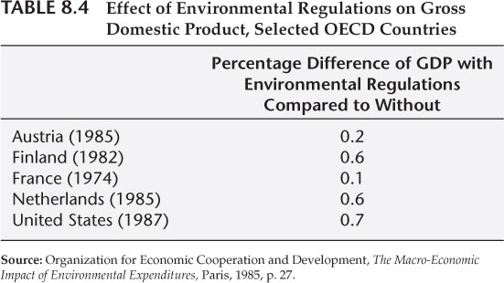
Macroeconomists predict only small decreases in GDP or increases
Environmental regulation can increase GDP growth if done correctly
William Nordhaus

Slide 63
Digression on Discounting

Slide 64
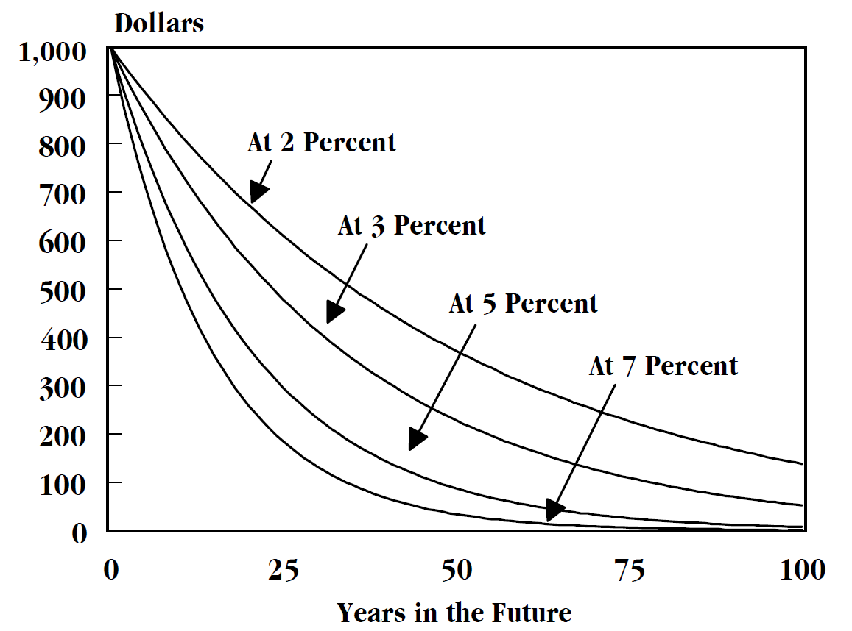
Time Value of money
A dollar today is worth less than a dollar tomorrow
Why? Inflation, opportunity cost, human nature
How do you compare two investments with different payoff schedules?

Slide 65
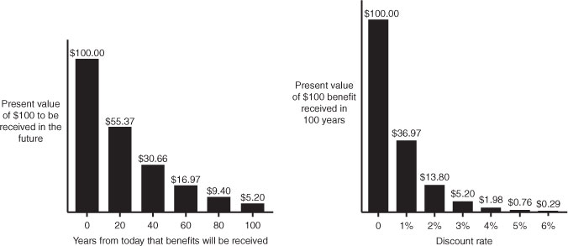
Diminishing value of money

Slide 66
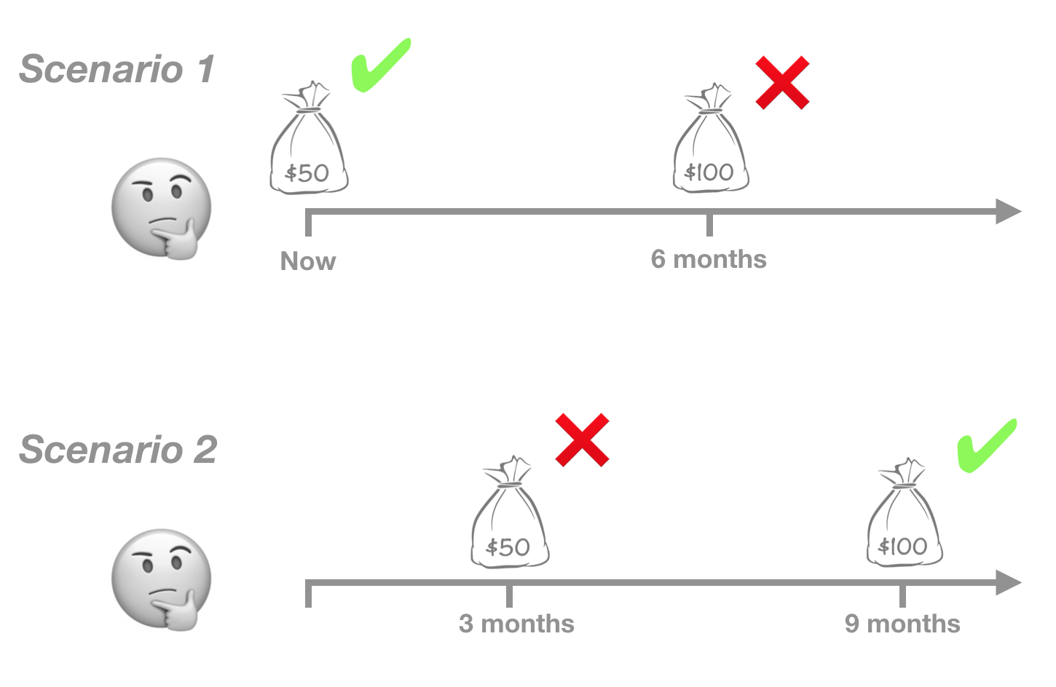
What is Discounting
Discounting allows us to compare investments with different
Opportunity cost of a dollar today is the highest return expected from a risk-free investment

Slide 67
Net Present Value
The discounted sum of cash flows over time
Used to evaluate the best investment
Of a perpetuity,$Σ_{\left\{t=0\right\}}^{∞}\frac{CF}{{(1+r)}^{\left\{t\right\}}}$ $=\frac{CF}{1−r}$
Benefits and costs may be accrued at different schedules

Slide 69
Cost of capital
Cost of debt plus cost of equity
What is the cost of equity? Debt?
Which one yields higher returns?
Which one is riskier?
Does it matter if you finance with debt or equity?

Slide 70
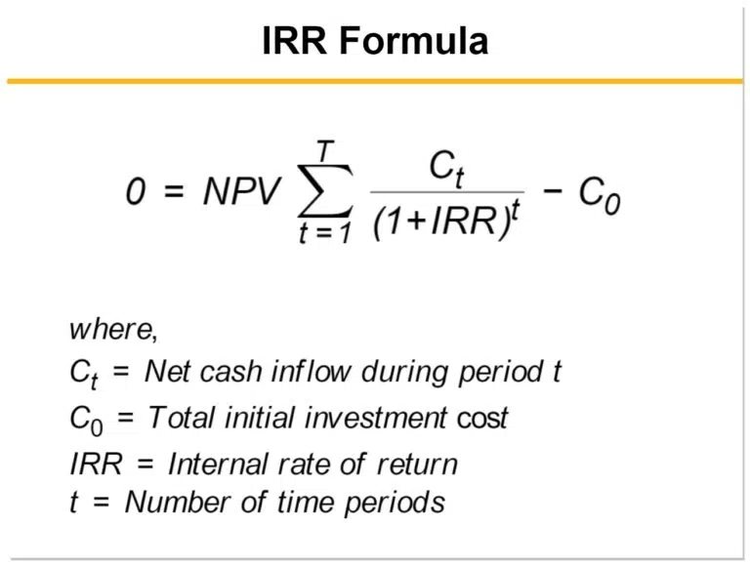
Internal rate of return
The internal rate of return is the
Choose projects with lowest IRR
Continue to take projects until IRR equals cost of capital

Slide 71
Future Value

Slide 72
Useful Excel Functions
NPV
NPV: Find net present value of a series of cash flows
Rate
Rate: Find unknown interest rate
IRR
IRR: Return internal rate of return for a series of cash flows
PMT
PMT: Given a rate, number of time periods, and total value what will payments be
IPMT
IPMT: Calculate interest portion of fixed debt payment
FV
FV: Find future value of an investment growing at rate

